Slide 1
Use Case Diagrams
Practical 5

Slide 2

Key Ideas
Use cases are a text-based method of describing and documenting complex processes
Use cases add detail to the requirements outlined in the requirement definition
Systems analysts work with users to develop use cases
Systems analysts develop process and data models later based on the use cases

Slide 3
Use Cases

Slide 4
Roles of Use Cases
A use case is a set of activities that produce some output result
Describes how the system reacts to an event that triggers the system
Trigger -- event that causes the use case to be executed
Event-driven modeling – everything in the system is a response to some triggering event

Slide 5
Role of Use Cases
All possible responses to the event are documented
Use cases are helpful when the situation is complicated

Slide 6
Sample Format for a
Written Use Case
Title – descriptive name, matches name in use case diagram
Primary actor – usually a user role
Stakeholders – any group or individual with an interest in the function of the use case
Precondition – conditions that must be satisfied in order to execute the use case

Slide 7
Building Use Cases

Slide 8
Step 1:
Identify the major use cases
Activities | Typical Questions Asked
Start a use case form for each use case If more than nine, group into packages | Ask who, what, and where about the tasks and their inputs and outputs: What are the major tasks performed? What triggers this task? What tells you to perform this task? What information/forms/reports do you need to perform this task? Who gives you these information/forms/reports? What information/forms/reports does this produce and where do they go?

Slide 9
Step 2: Identify the major steps within each use case
Activities | Typical Questions Asked
For each use case, fill in the major steps needed to process the inputs and produce the outputs | Ask how about each use case: How do you produce this report? How do you change the information on the report? How do you process forms? What tools do you use to do this step (e.g., on paper, by email, by phone)?

Slide 10
Step 3:
Identify elements within steps
Activities | Typical Questions Asked
For each step, identify its triggers and its inputs and outputs | Ask how about each step How does the person know when to perform this step? What forms/reports/data does this step produce? What forms/reports/data does this step need? What happens when this form/report/data is not available?

Slide 11
Step 4:
Confirm the use case
Activities | Typical Questions Asked
For each use case, validate that it is correct and complete | Ask the user to execute the process using the written steps in the use case – that is, have the user role-play the use case

Slide 12
Interim Summary
Use cases contain all the information needed for process modeling, but are easier for users to comprehend
Use cases are created in an iterative cycle of steps until they are considered accurate and complete

Slide 13
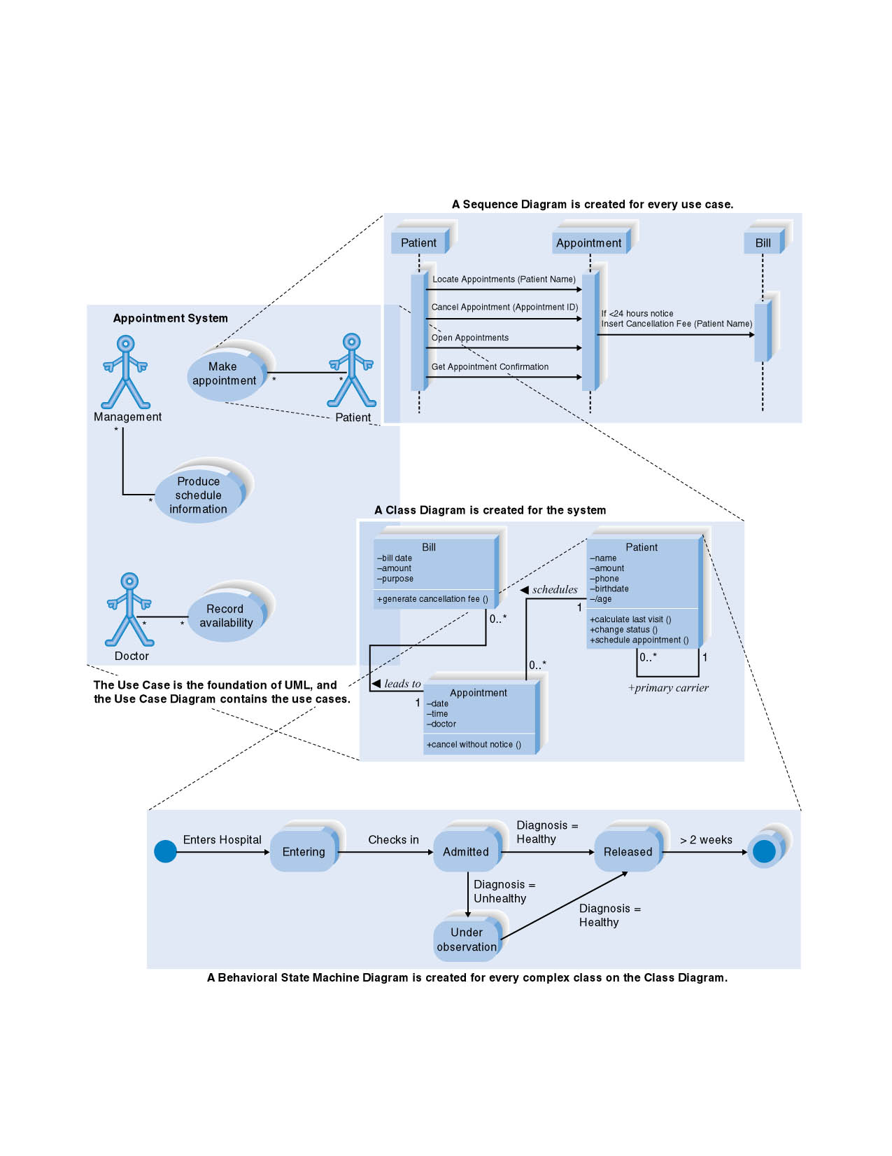
The Four Basic UML Diagrams

Slide 14
USE CASE DIAGRAM

Slide 15
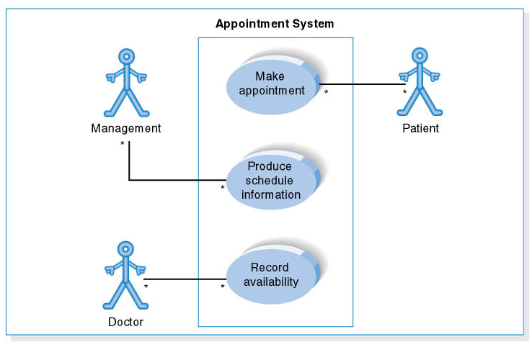
Use Case Diagram for Appointment System

Slide 16
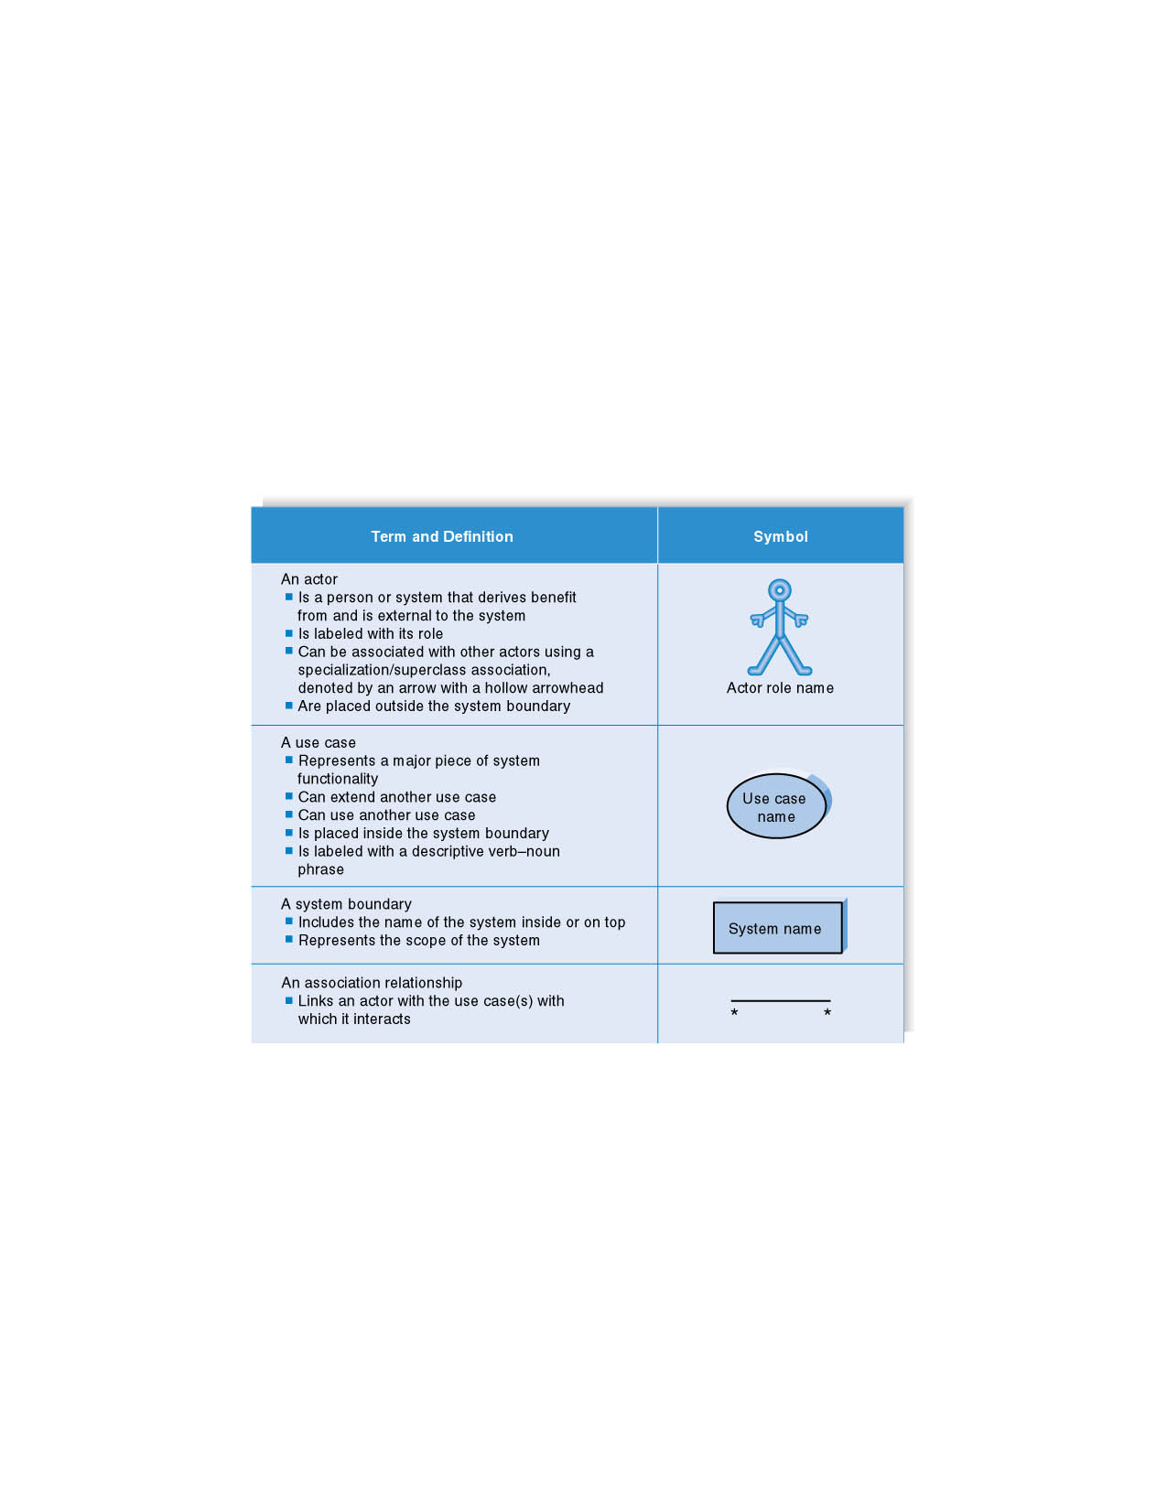
Syntax for Use Case Diagram

Slide 17
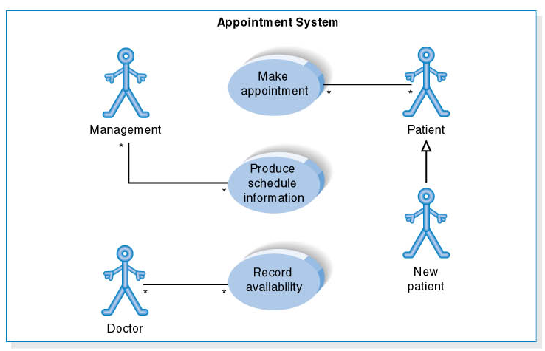
Use Case Diagram for Specialized Actor

Slide 18
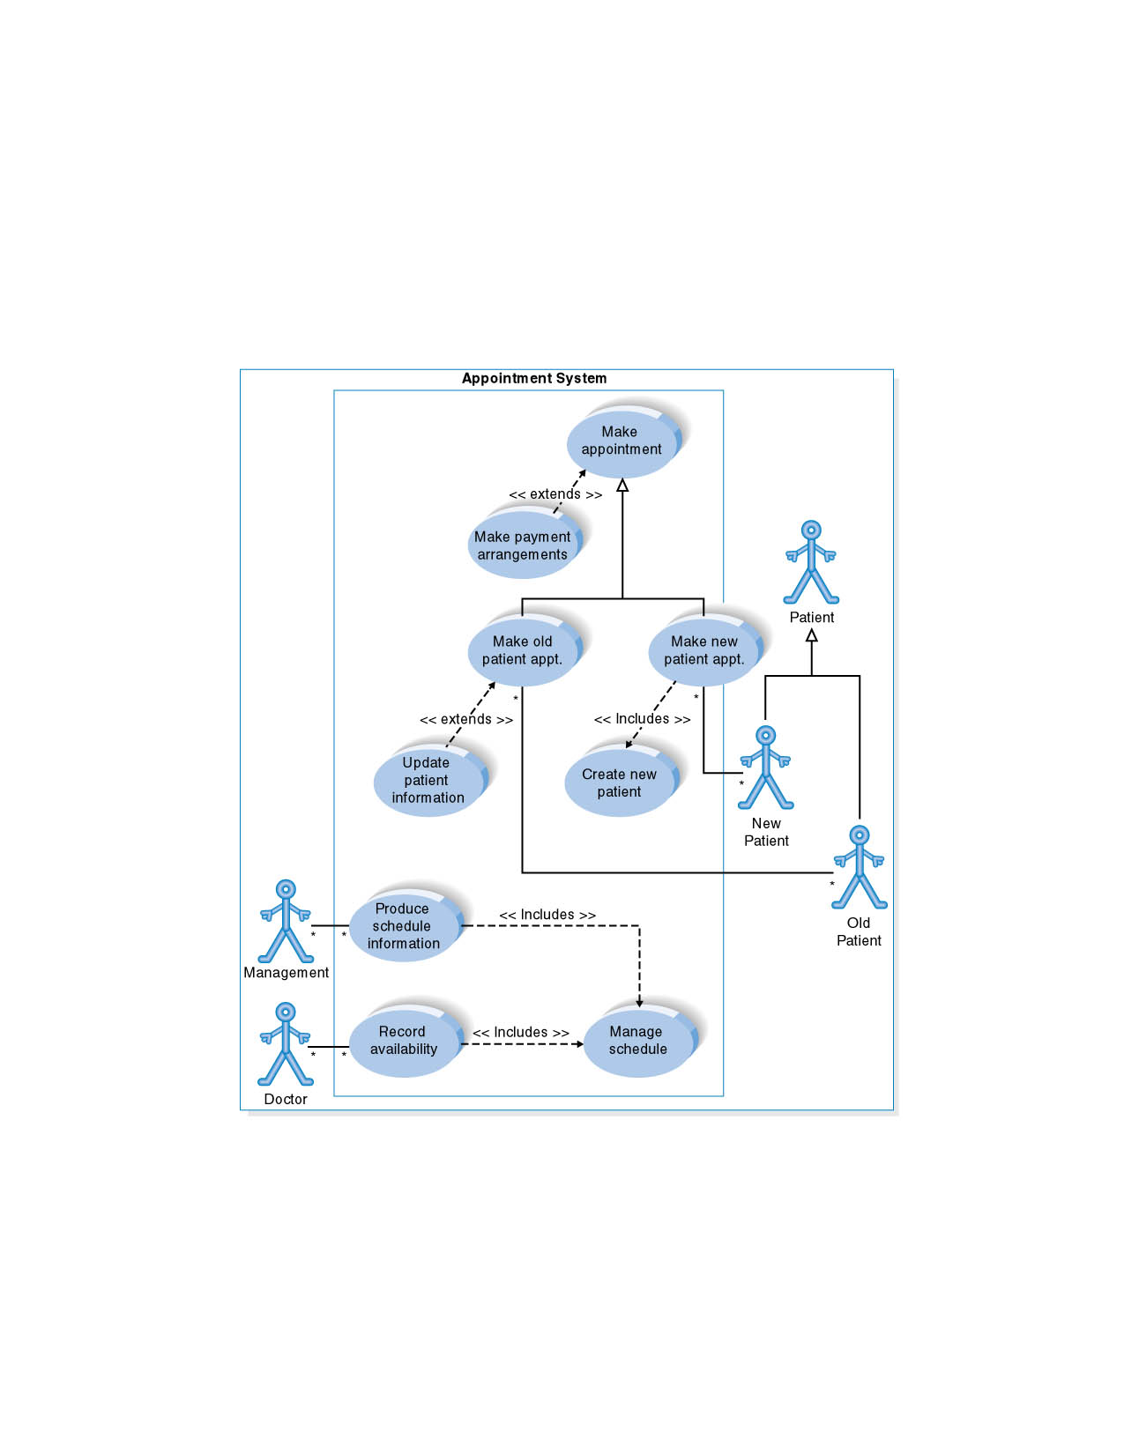
Extends and Includes Associations

Slide 19
Steps in Creating the Use Case Diagram
1. Identify Use Cases
2. Draw the system boundary
3. Place Use Cases on the diagram
Group Use Cases into packages
Add special Use Case associations
4. Identify the actors
5. Add associations

Slide 20
Use Case Concept
Use case is one way of representing system functionality.
Use case refers to
  A system’s behavior (functionality)
  A set of activities that produce some output.
Think in terms of main processes happening in the system.
In the simplest form, use case is a list of functions for a user;
Example →
Use verbs for naming use cases.

Slide 21
Actor Concept
Actor is someone or something interacting with use case.
Similar to the concept of user, although the user can appear
as different actors (e.g., a prof. can be instructor and researcher).
Actor triggers use case.
Each Actor must be linked to a use case, while some use cases may not be linked to actors.
Actor—Use Case: Actor has responsibility toward the system (inputs), and Actor have expectations from the system (outputs).
Careful: Lines between Actors and Use Cases are NOT data flows!

Slide 22
Use Case Symbols
Use Case
        Actor
Boundary
      Connection
Include relationship
Extend relationship
Note: different names
used in different software
<<include>>
<<extend>>

Slide 23
Use Case Diagram
A diagram representing system’s behavior—use cases and actors.
Provides a global look of a system – it’s basic functionality
(use cases) and environment (actors).
Useful for early structuring of requirements; iterative revisions.
May be understood by users on the intuitive level.

Slide 24
Extend Relationship between Use Cases
Extend relationship –
linking an optional use case to a standard use case.
Example: Register Course (standard use case) may have
Register for Special Class (extend use case).
Standard use case can execute without the extend case.
→ loose coupling
See next slide →

Slide 25
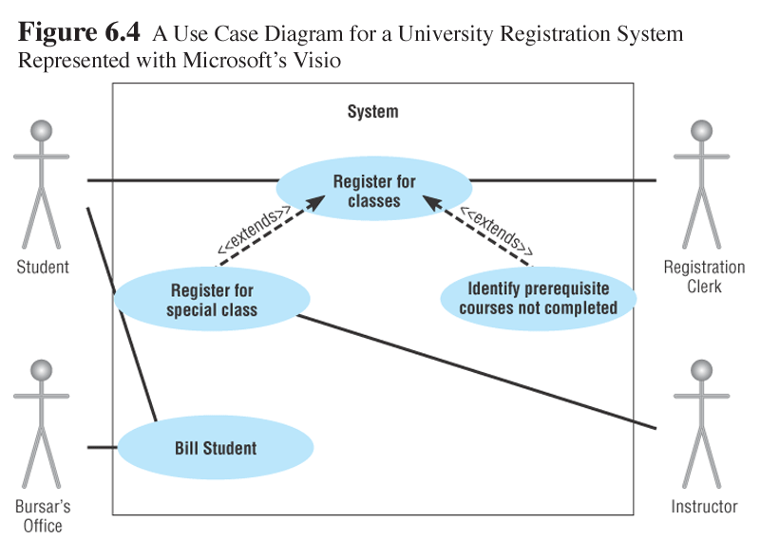
Extend Relationship Between Use Cases
Careful: Arrows between Use Cases are NOT data flows!

Slide 26
Include Relationship Between Use Cases
Include relationship –
a standard case linked to an mandatory use case.
Example: to Authorize Car Loan (standard use case), a clerk must run Check Client’s Credit History (include use case).
→ tight coupling
Standard use case can NOT execute without the include case.
See next slide →

Slide 27
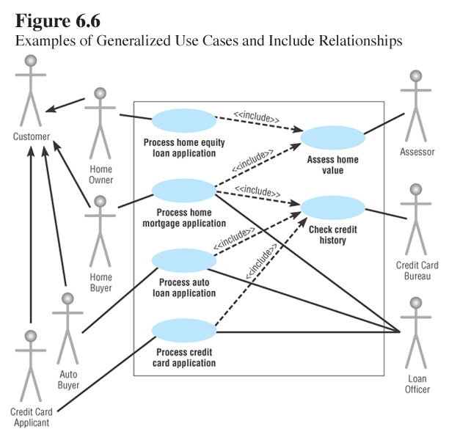
Include Relationship Between Use Cases
Careful: Arrows between Use Cases are NOT data flows!

Slide 28
Use Case Description
Use cases start with a textual description – some content
similar to use case diagrams, some new details included.
Some important details to show:
- Name of use case
- Objective
- Level (high, mid, low)
- Actor
- Interactions between use case and actor
(see Figure 6-4 and textual description on p. 188)

